Slide 1
pointers

Slide 2
Agenda
Pointers
Pointer Declaration and Initialization
Pointer Arithmetic
Pointer Comparison
Pointer expressions
Example Programs
Benefits of Pointers
Pointers to Pointers
Pointers and Arrays
Pointers and character strings
Array of Pointers
Pointers as Function Arguments
Functions returning Pointers
Pointers to Functions
Pointers and Structures
Trouble with Pointers
References

Slide 3
Pointers
A variable that holds a memory address.
This address is the location of another object in the memory.
Pointer as an address indicates where to find an object.
The most useful, powerful and tricky concept in C language.
Makes C very fast.
Direct interaction with hardware.
Solves very complicated programming problems
Not all pointers actually contain an address.
Example- NULL pointer.
Value of NULL pointer is 0.

Slide 4

How does a memory look like ?
Address Locations
X1000
X1004 X1008 X100c x1010
X1000
X1001
X1002
X1003

Slide 5
*
Operators used in Pointers
&
(Address of)
Dereferencing
Address
(Value at)

Slide 6
Int i=3;
Address of ‘i’
Value of ‘i’
‘&i’
‘*i’
variable
i
 |  |  | 3 (Value of i)
x1000
x1004 x1008 x100c x1010
Address of i
The value ‘3’ is saved in the memory location ‘x100c’
x1014

Slide 7
Pointer Declaration & Initialization
When you write int *, compiler assumes that any address that it holds points to an integer type.
Eg:- int count, *m;
m= &count;
It means memory address of count variable is stored into m. & is unary operator that returns the memory address. i.e. & (ampersand) is returning the address.
It means m receives the address of count.
Suppose, count uses memory address 2000 to store its value 100.
So, m=&count means m has address 2000.
q= *m
it returns the value at address m. value at address 2000 is 100.
so, q will return value 100.
i.e. q receives the value at address m.
count=100
2000

Slide 8
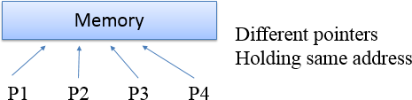
It is possible in some environments to have multiple pointer values with different representations that point to same location in memory.

Slide 9
Example
main()
{
int j=3;
printf(“address of j =%u”,&j);
printf(“value of j =%d”,j);
printf(“value of j =%d”,*(&j));
}
Output:
address of j=65524
value of j =3
value of j =3
main()
{
int j=3;
printf(“address of j =%u”,&j);
printf(“value of j =%d”,j);
}
Output:
address of j=65524
value of j =3

Slide 10
Pointer Arithmetic
There are only two arithmetic operations that can be used on pointers
Addition
Subtraction
To understand this concept, lets p1 be an integer pointer with value 2000 address.
int is of 4 bytes
After expression p1++;
P1 contains address 2004 not 2001.
Each time p1 is incremented, it will point to next integer.
The same is true for decrement.
for p1--;
Causes value of p1 to be 1996.
Each time a pointer is incremented, it points to the memory location of the next element of its base type.
If decremented, then it points to previous element location.
p1=p1+12; makes p1 points to 12th element of p1 type.

Slide 11
Pointer Arithmetic Example 2
Lets take this example program
#include<stdio.h>
void main()
{
b = 1
b=1+4
b= 5
int a [5]={1,2,3,4,5} , b , *pt ;
a[0] | a[1] | a[2] | a[3] | a[4]
pt = &a[0];
pt = pt + 4 ; //pt is incremented by 4 consecutive memory locations
b=a[0] ;
b+=4 ;
}
x1000
pt
x1004
x1008
x100c
x1010
a[0] b | a[1] | a[2] | a[3] | a[4]
x1000
x1004
x1008
x100c
x1010

Slide 12
Arithmetic Rules
You cannot multiply or divide pointers.
You cannot add or subtract two pointers.
You cannot apply bitwise operators to them.
You cannot add or subtract type float or double to or from pointers.

Slide 13
Pointer Comparison
You can compare two pointers in a relational expression,
Example:
if(p<q)
printf(“p points to lower memory than q \n”);
Pointer comparison are useful only when two pointers point to a common object such as an array.

Slide 14
Pointer Expressions
If p1 and p2 are properly declared and initialized pointers then, ‘C’ allows adding integers to a pointer variable. EX: int a=5, b=10; int *p1,*p2; p1=&a; p2=&b;
Now, p1=p1+1=1000+2=1002; p1=p1+2=1000+ (2*2) =1004; p1=p1+4=1000+ (2*4) =1008; p2=p2+2=3000+ (2*2) =3004; p2=p2+6=3000+ (2*6) =3012;

Slide 15
Pointer Expressions
If p1 & p2 are properly declared and initialized, pointers then ‘C’ allows to subtract integers from pointers. From the above example, p1=p1-1=1000-2=998; p1=p1-2=1000-4=996; p1=p1-4=1000-8=992; p2=p2-2=3000-4=2996; p2=p2-6=3000-12=2988;

Slide 16
Pointer Expressions
-> If p1 & p2 are properly declared and initialized pointers, and both points to the elements of same type. “Subtraction of one pointer from another pointer is also possible". NOTE: this operation is done when the both pointer variable points to the elements of the same array. EX: p2- p1 (It gives the number of elements between p1 and p2) -> Pointer can also be used with increment and decrement operators.
int num = 5; // Suppose address of num = 1000
int *ptr; // Pointer variable
ptr = &num; // ptr points to 1000 or ptr points to num
ptr++; // ptr now points to 1002, since integer size is 2 bytes
ptr--; // ptr now points to 1000

Slide 17
Example Program 3
void main()
{
int num=10;
int *pnum=NULL;
pnum = &num;//pnum=address of num
*pnum += 20; //pnum=pnum+20
printf("\nNumber = %d", num);
printf("\nPointer Number = %d", *pnum);
}
OUTPUT
Number = 10 Pointer Number = 30

Slide 18
Example Program 4
void main()
{
int a[10] = {1,2,3,4,5,6,7,8,9,12} ,*p, *q , i;
p = &a[2];// address of the element 3
q = &a[5]; //address of the element 6
i = *q - *p;//6-3
printf(“The value of i is %d” i );
i = *p - *q;//3-6
printf(“The value of i is %d” i );
a[2] = a[5] = 0;
i = *p - *q;
printf(“The value of i is %d” i );
}
OUTPUT
The value of i is 3 The value of i is -3 The value of i is 0

Slide 19
Example Program 5
void main()
{
int a[10] = { 2,3,4,5,6,7,8,9,1,0 }, *p, *q;
p = &a[2]; // address of 4
q = p + 3; // address of 7
p = q – 1; // address of 6
p+ + ;//address of 7
printf(“The value of p and q are : %d , %d” *p,*q);
}
OUTPUT
The value of p and q are : 7 , 7

Slide 20
Benefits of pointer
Pointers are used in situations when passing actual values is difficult or not desired.
To return more than one value from a function.
They increase the execution speed.
Pointers are more efficient in handling the data types.
Pointers reduce the length and complexity of a program.
Implementing linked lists, trees, graphs and many other data structure.

Slide 21

Pointers to Pointers
Pointer variable is just a place-holder of an address value, and itself is a variable.
Hence a pointer can hold address of (point to) another pointer variable. It is called a “double pointer” or a chain of pointers or a pointer to pointer.
When we define a pointer to a pointer, the first pointer contains the address of the second pointer, which points to the location that contains the actual value.
Declaration:
int **var;
When a target value is indirectly pointed to by a pointer to a pointer, accessing that value requires that the asterisk operator be applied twice.

Slide 22
Pointers and Arrays
int val[5]={10,20,30,40,50};
int *p
if p = &val[0] which means *p ==val[0]
If (p+1) == &val[2] and *(p+1) == val[2]
If (p+2) == &val[3] and *(p+2) == val[3]
(p+n) == &val[n+1] and *(p+n) == val[n+1]

Slide 23
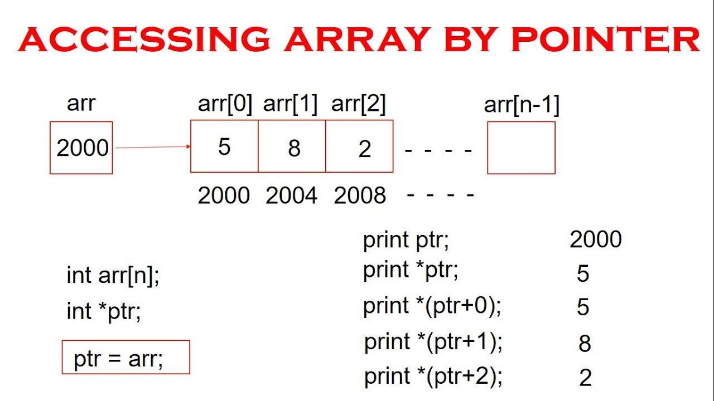

Slide 24
Example Program 7
/*program to compute sum of all elements stored in an array using pointers*/
#include<stdio.h>
#include<conio.h>
main ()
{
int a [10], I, sum=0,*p;
printf (“enter 10 elements \n”);
for (i=0; i<10; i++)
scanf (“%d”, & a[i]);
p=a;
for (i = 0; i<10; i++)
{
sum = sum+ *p;
p++;
}
printf (“the sum is % d”, sum);
getch ();
}

Slide 25
Example Program 9
#include <stdio.h>
main(void)
{
char str[6] = "HELLO"; // string variable
char *ptr = str; // pointer variable
int len;
printf(“%s\n”, str);
while(*ptr != '\0') // print the string
{
printf("%c is stored at %u", *ptr, ptr);
// move the ptr pointer to the next memory location
ptr++;
}
len=ptr-str;
printf(“The length of the string is= %d\n”, len);
}
OUTPUT
HELLO
H is stored at 62
E is stored at 63
L is stored at 64
L is stored at 65
O is stored at 66
The length of the string is= 5

Slide 26
Pointers as Function Arguments
Pointer as a function parameter is used to hold addresses of arguments passed during function call.
This is also known as call by reference.
When a function is called by reference any change made to the reference variable will effect the original variable.

Slide 27
Example Program 11
/* Program to swap 2 numbers using pointer*/
#include <stdio.h>
void swap(int *a, int *b);
int main()
{
int m = 10, n = 20;
printf("m = %d\n", m);
printf("n = %d\n\n", n);
//passing address of m and n to the swap function
swap(&m, &n);
printf("After Swapping:\n\n");
printf("m = %d\n", m);
printf("n = %d", n);
return 0;
}
/* pointer 'a' and 'b' holds and points to the address of 'm' and 'n' */
void swap(int *a, int *b)
{
int temp;
temp = *a;
*a = *b;
*b = temp;
}
OUTPUT:
m = 10
n = 20
After Swapping:
m = 20
n = 10

Slide 28
Functions returning Pointer variables
A function can also return a pointer to the calling function.
It is to be noted that local variables of function doesn't live outside the function.
They have scope only inside the function.
Hence if you return a pointer connected to a local variable, that pointer will be pointing to nothing when the function ends.
Use argument with functions. Because argument passed to the functions are declared inside the calling function, hence they will live outside the function as well.

Slide 29
Pointer to functions
It is possible to declare a pointer pointing to a function which can then be used as an argument in another function.
A pointer to a function is declared as follows,
type (*pointer-name)(parameter);
Eg:
int sum(int, int); //function declaration
int (*s)(); //legal declaration of pointer to function
int *s(); //This is not a declaration of pointer to function. It returns pointer of type int.

Slide 30
Pointer to functions
.
A function pointer can point to a specific function when it is assigned the name of that function.
int sum(int, int);
int (*s)(int, int);
s = sum;
Here, s is a pointer to a function sum. Now sum can be called using function pointer s along with providing the required argument values.
s (10, 20) ; => sum(10,20);

Slide 31
Example Program 13
#include <stdio.h>
int main( )
{
int s;
int sum(int x, int y);
int (*fp)(int, int);
fp = sum;
s = fp(10, 15);
printf("Sum is %d", s);
return 0;
}
int sum(int x, int y)
{
return x+y;
}
OUTPUT:
25

Slide 32
Pointers and Structures
Name of an array stands for the address of its zeroth element.
Same applies for the names of arrays of structure variables.
Eg:
struct inventory
{
char name[30];
int number;
float price;
}product[2], *ptr;
Here, product is an array of 2 elements, each of type struct inventory and ptr as a pointer to data objects of type struct inventory.

Slide 33
Pointers and Structures
ptr=product
Would assign the address of the zeroth element of product to ptr.
i.e., ptr points to product[0].
Its members can be accessed using:
ptr->name
ptr->number
ptr->price
When ptr is incremented by one, it points to the next record. i.e., product[1].
The following for statement will print the values of members of all the elements of product array.
for(ptr=product; ptr<product+2; ptr++)
printf(“%s %d %f\n”, ptr->name, ptr->number, ptr->price);

Slide 34
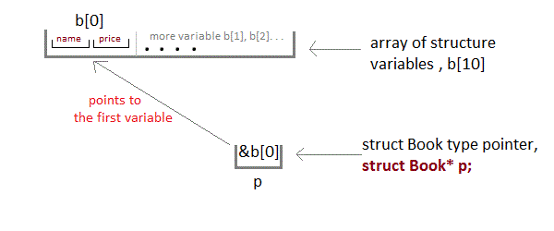
Example Program 14
#include <stdio.h>
struct Book
{
char name[10];
int price;
}b[10], *ptr;
main()
{
//reading the members of array of structures using pointer
for(ptr=b; ptr<b+10; ptr++)
scanf(“%s %d \n”, ptr->name, &ptr->price);
ptr = b;
//displaying the array of structures using pointer
while(ptr<b+10)
{
printf(“%s %d \n”, ptr->name, ptr->price);
ptr++;
}
}

Slide 35
Trouble with Pointers
Since pointer holds address of memory location, it must never be used without proper initialization.
Not de- referencing a pointer when required.
An uninitialized pointer does not know the memory location it is pointing to.
A pointer cannot track boundaries of an array.
Comparing pointers that point to different objects.

Slide 36
References
Slideshare
https://www.tutorialspoint.com/cprogramming/c_pointers.htm
https://dyclassroom.com/c/c-pointers-and-strings
https://www.studytonight.com/c/pointer-with-function-in-c.php
https://www.studytonight.com/c/pointers-to-structure-in-c.php

Slide 37
THANK YOU

